Slide 1
Data
数据分析课程报告
Analysis
福建师范大学
叶继禹 121052021010
范嘉明 121052021038
徐松福 121052021023

Slide 2
1
任务一 指标计算
2
任务二 股票推荐
目录
CONTENTS
3
任务三 股票预测
4
任务四 证券买卖

Slide 3

If you want , you can delete the text , you can add some words here as you like. If you want , you can delete the text , you can add some words here as you like. If you want , you can delete the text , you can add some words here as you like. If you want , you can delete the text , you can add some words here as you like.
If you want , you can delete the text , you can add some words here as you like. If you want , you can delete the text , you can add some words here as you like.
绪论

Slide 4
1
第一章标题
Subtitle of the first chapter

Slide 5
输入项目标题
If you want , you can delete the text , you can add some words here as you like. If you want , you can delete the text ,
项目标题
项目标题
If you want , you can delete the text , you can add some words here as you like. If you want , you can delete the text , you can add some words here as you like.
If you want , you can delete the text , you can add some words here as you like. If you want , you can delete the text , you can add some words here as you like. If you want , you can delete the text , you can add some words here as you like.
项目标题

Slide 6


输入项目标题
项目标题
If you want , you can delete the text , you can add some words here as you like. If you want , you can delete the text , you can add some words here as you like.
项目标题
If you want , you can delete the text , you can add some words here as you like. If you want , you can delete the text , you can add some words here as you like.

Slide 7

If you
want
you
can
delete
the text

Slide 8
2
第一章标题
Subtitle of the first chapter

Slide 9
输入项目标题
项目标题
项目标题
项目标题
If you want , you can delete the text .
If you want , you can delete the text .
If you want , you can delete the text .

Slide 10
输入项目标题
项目标题
项目标题
If you want , you can delete the text , you can add some words here as you like. If you want , you can delete the text , you can add some words here as you like.
If you want , you can delete the text , you can add some words here as you like. If you want , you can delete the text , you can add some words here as you like.
If you want , you can delete the text , you can add some words here as you like. If you want , you can delete the text , you can add some words here as you like.
If you want , you can delete the text , you can add some words here as you like. If you want , you can delete the text , you can add some words here as you like.
项目标题
项目标题

Slide 11
输入项目标题
项目标题
项目标题
项目标题
If you want , you can delete the text .
If you want , you can delete the text .
If you want , you can delete the text .

Slide 12
3
股票预测

Slide 13
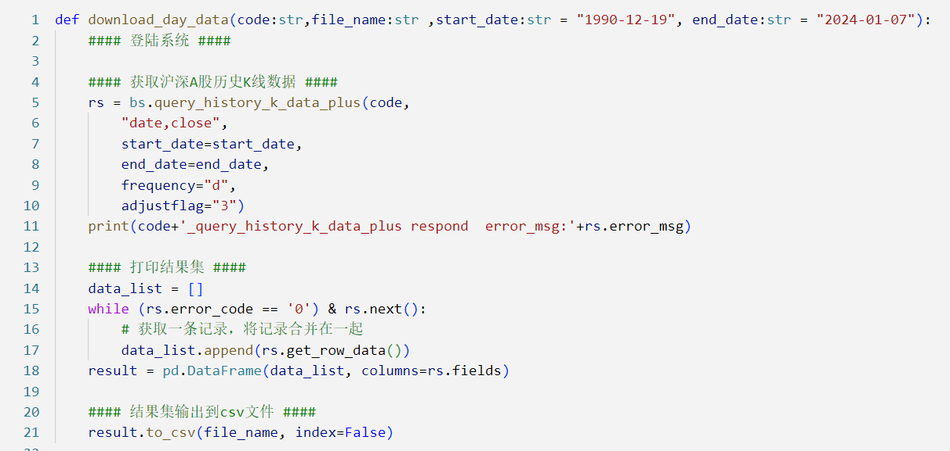
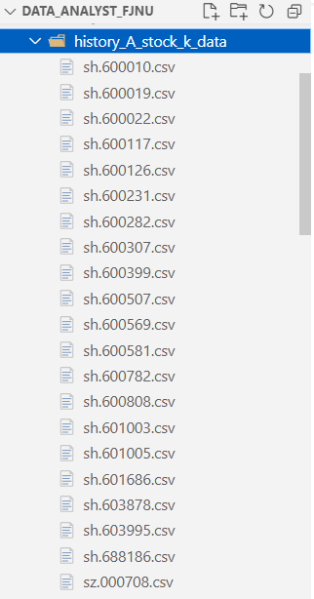
数据下载

Slide 14
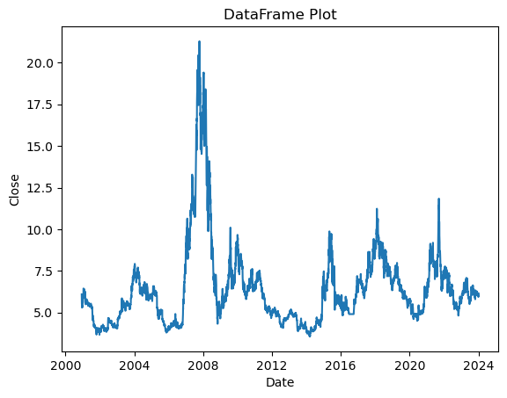
数据探索

Slide 15

LSTM

Slide 16
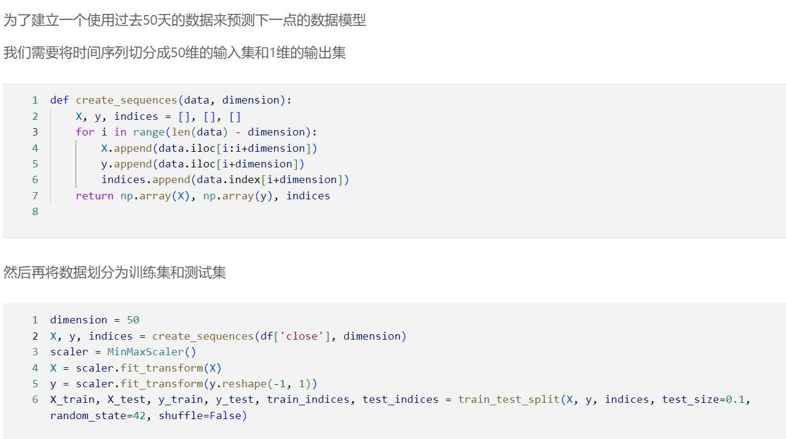
数据切片

Slide 17
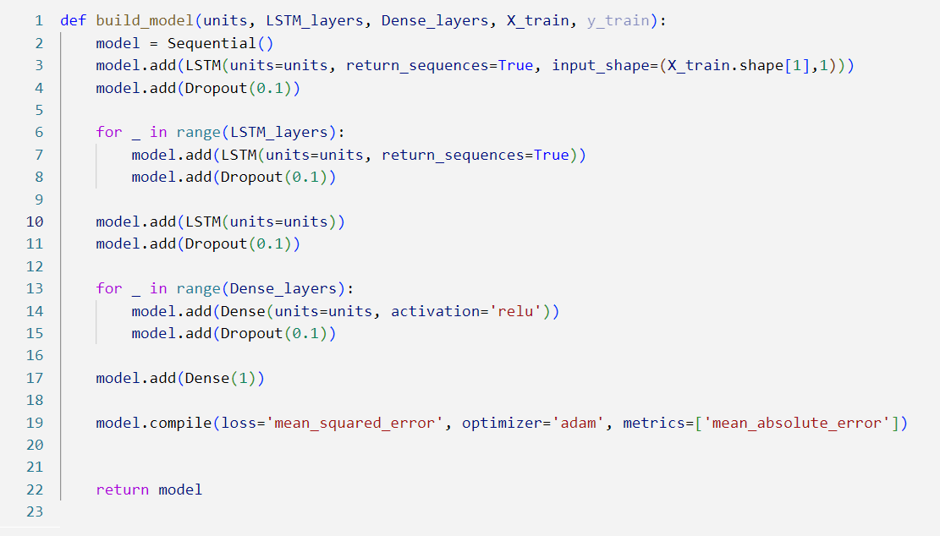
模型结构

Slide 18
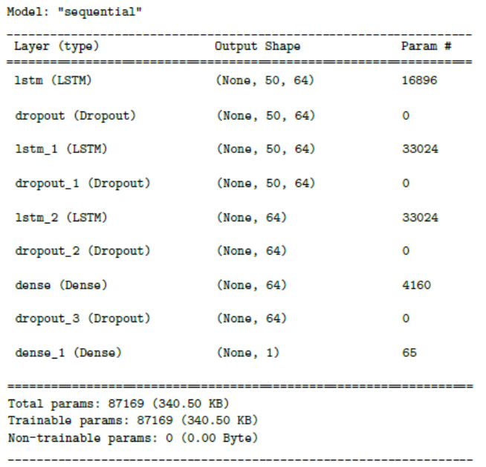
模型结构

Slide 19
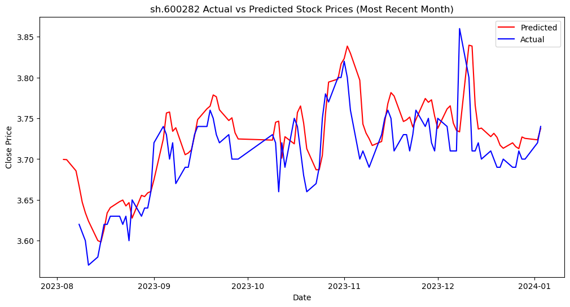
预测效果

Slide 20
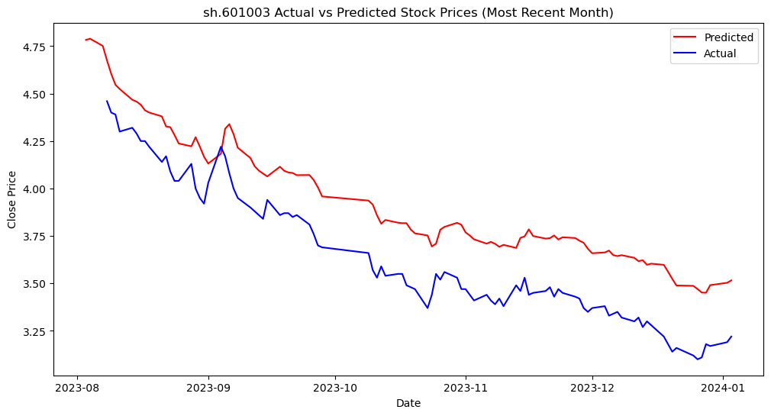
预测效果

Slide 21
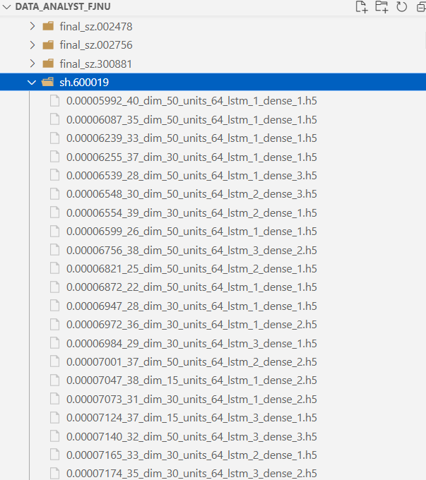
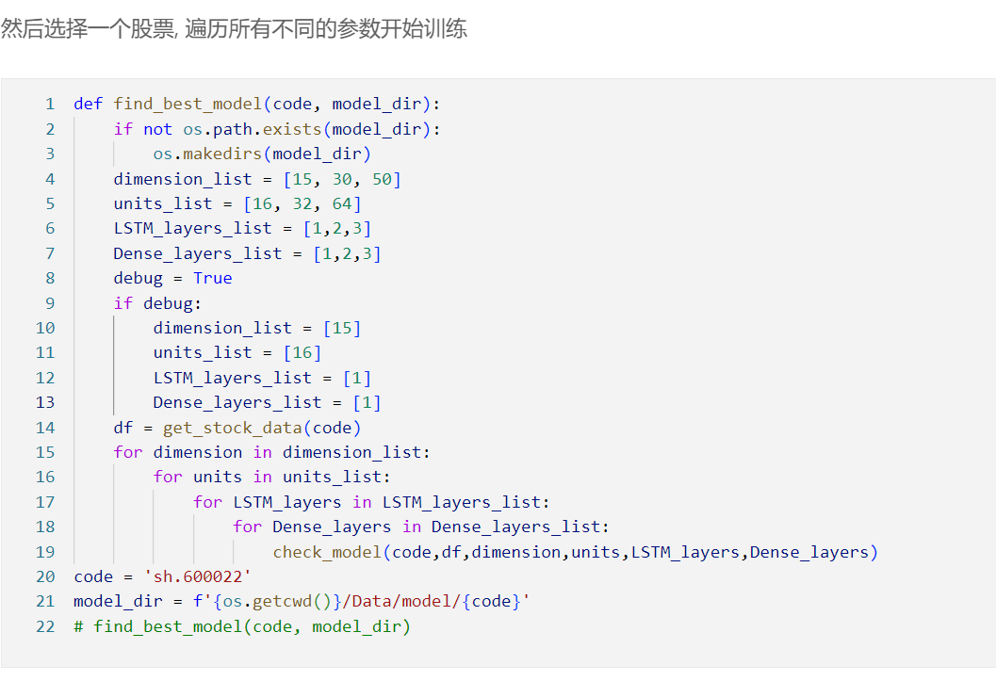
参数选择

Slide 22
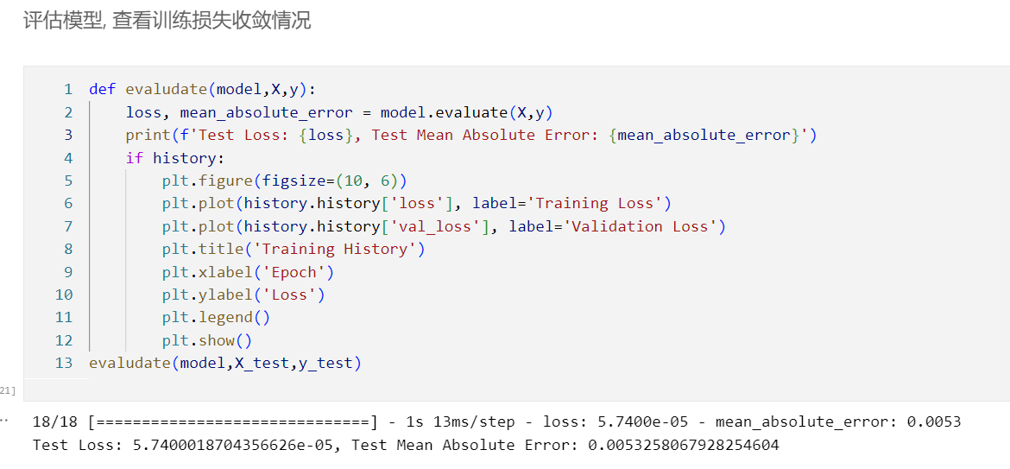
模型评估

Slide 23
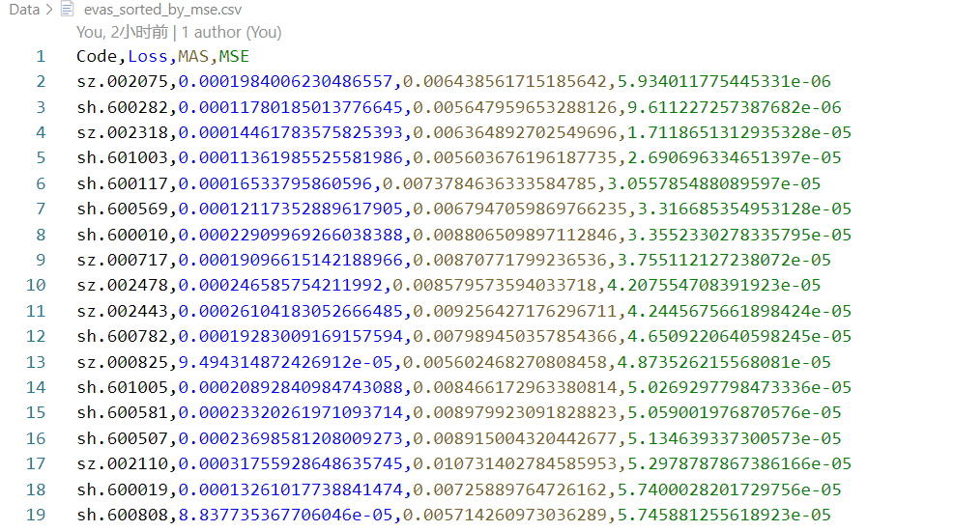
股票选择

Slide 24
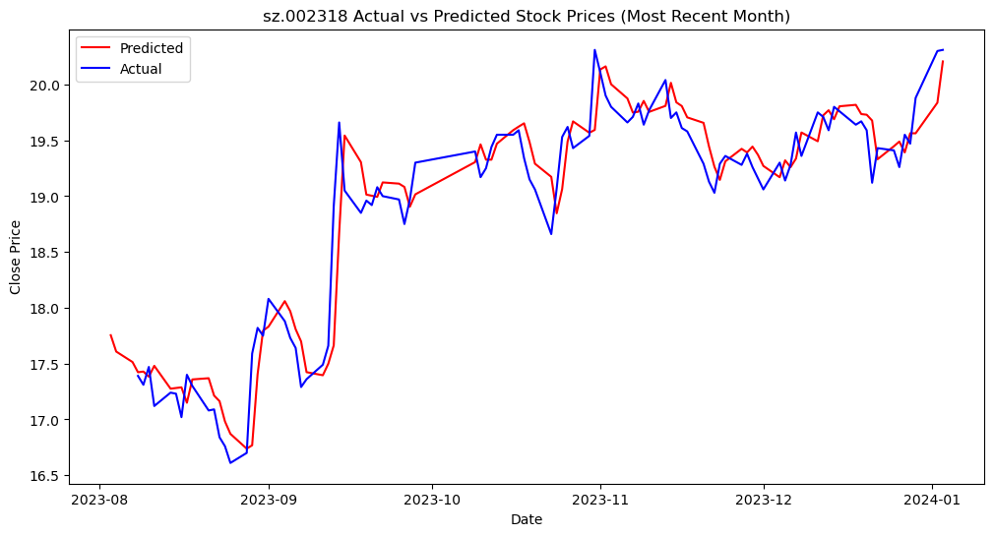
预测效果

Slide 25
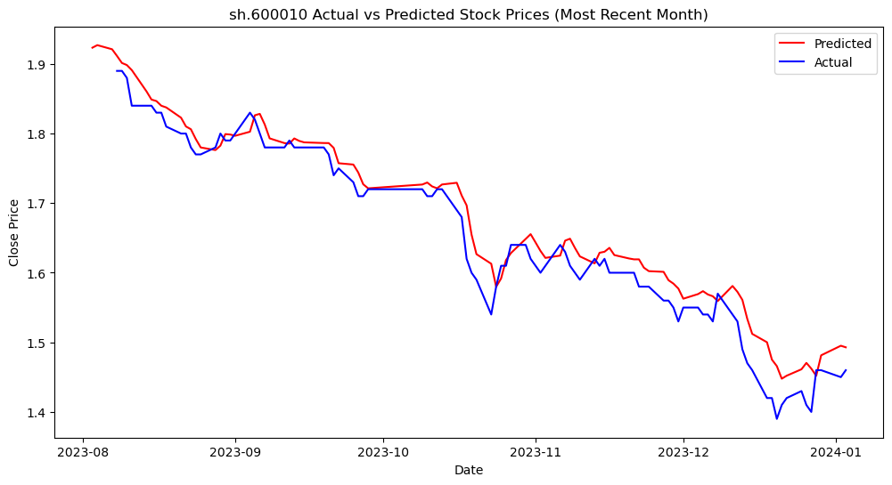
预测效果

Slide 26
最终预测

Slide 27
4
证券买卖

Slide 28
模型复用

Slide 29
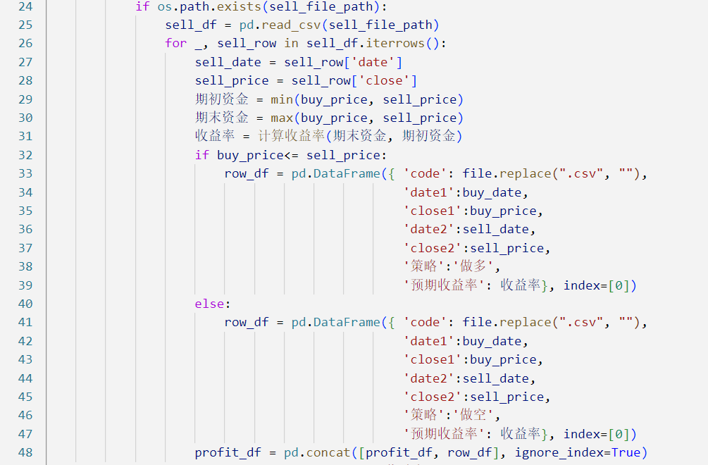
最大收益

Slide 30
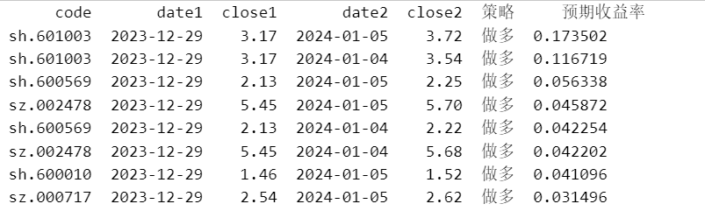
预期收益率

Slide 31
真实收益率

Slide 32

项目标题
If you want , you can delete the text . If you want , you can delete the text , you can add some words here as you like. If you want , you can delete the text , you can add some words here as you like.

Slide 33
THANKS
FOR YOUR LISTENING

